Slide 1
Course Capstone Project Proposal Title:
ECG‑Based Heart Rate Monitoring System
Course Code: | EEE 4103 | Course Name: | Microprocessor and Embedded Systems
Course Teacher: Protik Parvez Sheikh
Assistant Professor
Department of Electrical and Electronic Engineering
SL # | Students ID | Students Name | Program | Section
1 | 23-50873-1 | MUKADDAS MAHDI ULLAS | BSc in CSE | A
2 | 23-50895-1 | NABILA HOQUE | BSc in CSE | A
3 | 23-50897-1 | MD. MOSTAFA HAMID YEASIB | BSc in CSE | A
4 | 23-50944-1 | REPHA TASNEYA | BSc in CSE | A
5 | 23-52623-2 | KAZI WARISA TABASSUM | BSc in CSE | A

Slide 2

.
Introduction
Aim and objection of the work
To design a low-cost ECG-based heart rate monitoring system
To acquire real-time ECG signals using the AD8232 sensor
To implement R-peak detection for accurate BPM calculation
To display ECG waveform and BPM on an OLED screen
To test system performance using USB and battery power
To validate the system performance by comparing measured BPM values with expected physiological ranges.

Slide 3
Introduction
Background of Study and Motivation
ECG (Electrocardiogram) monitors the electrical activity of the heart
Heart rate monitoring is crucial for early cardiac risk detection
Conventional ECG systems are expensive and non-portable
Embedded technology enables low-cost and compact medical devices
Growing need for real-time, accessible cardiac monitoring solutions

Slide 4
Introduction
Brief Outline of the Presentation
Introduction and motivation of the proposed project
Review of related works and recent research
Methodology and system working principle
Hardware implementation and experimental setup
Results analysis and performance discussion
Cost analysis, limitations, and conclusion

Slide 5
Literature Review
Previous Works on ECG-Based Heart Rate Monitoring
Khan et al. developed an ECG monitoring system using AD8232 and Arduino for basic heart rate measurement
Smith et al. implemented ECG signal acquisition with microcontroller-based display systems
Patel et al. proposed a wearable ECG monitoring device focusing on portability
Rahman et al. used low-cost sensors for real-time ECG visualization and BPM calculation
Common Achievements:
Successful ECG signal acquisition
Basic R-peak detection and BPM calculation
Low-cost and educational implementations

Slide 6
Literature Review
Research Gaps and Contribution of This Work
Identified Gaps in Previous Studies:
Limited focus on real-time waveform visualization with BPM together
Poor noise handling and unstable signal display
Lack of clear experimental validation
Limited discussion on power flexibility (USB vs battery)
Improvements in the Proposed Work:
Simultaneous real-time ECG waveform and BPM display on OLED
Stable operation using USB and battery power supply
Simple, compact, and cost-effective hardware design
Suitable for educational and preliminary health monitoring applications

Slide 7
Methodology and Modeling
Working Principle of the Proposed Project
The system continuously senses the electrical impulses of the heart
The ECG sensor detects voltage changes produced during each cardiac cycle
These signals are converted into analog ECG signals
The Arduino reads and processes the ECG signal
A threshold‑based method detects each heartbeat (R‑peaks)
Heart Rate (BPM) = 60,000 ÷ time between two R‑peaks (ms)
The calculated BPM is displayed on the OLED screen
A dynamic ECG waveform is also shown in real time
This allows continuous real‑time heart‑monitoring

Slide 8
Methodology and Modeling
Process of Work
Signal Acquisition
The AD8232 ECG sensor is connected to the Arduino to capture the analog ECG signal from the body.
Signal Processing
The Arduino detects R‑peaks using a threshold‑based algorithm and calculates the heart rate (BPM) from the time difference between consecutive beats.
Data Visualization
The BPM is displayed numerically on the OLED screen, while the ECG waveform is shown in real‑time for visual observation.
Continuous Monitoring
The system continuously updates both the BPM and ECG waveform to reflect real‑time heart activity.

Slide 9
Methodology and Modeling
Process of Work
Signal Acquisition
The AD8232 ECG sensor is connected to the Arduino to capture the analog ECG signal from the body.
Signal Processing
The Arduino detects R‑peaks using a threshold‑based algorithm and calculates the heart rate (BPM) from the time difference between consecutive beats.
Data Visualization
The BPM is displayed numerically on the OLED screen, while the ECG waveform is shown in real‑time for visual observation.
Continuous Monitoring
The system continuously updates both the BPM and ECG waveform to reflect real‑time heart activity.

Slide 10
Methodology and Modeling
Description of the Components
Component | Function
ECG Sensor (AD8232) | Captures electrical signals from the heart and outputs corresponding analog voltages for cardiac cycles.
Arduino Microcontroller (Uno/Nano) | Reads analog ECG signals, detects heartbeats using threshold-based logic, calculates BPM, and sends data to the OLED display.
OLED Display (128×64) | Displays the real-time heart rate (BPM) numerically and visualizes the ECG waveform dynamically.
Resistors & Wires | Ensure proper electrical connections, signal stability, and reliable operation of the circuit.
Power Supply (Laptop USB, 5 V) | Provides stable 5 V DC to the Arduino and ECG sensor, eliminating the need for an external adapter or battery while enabling serial monitoring and data logging.

Slide 11
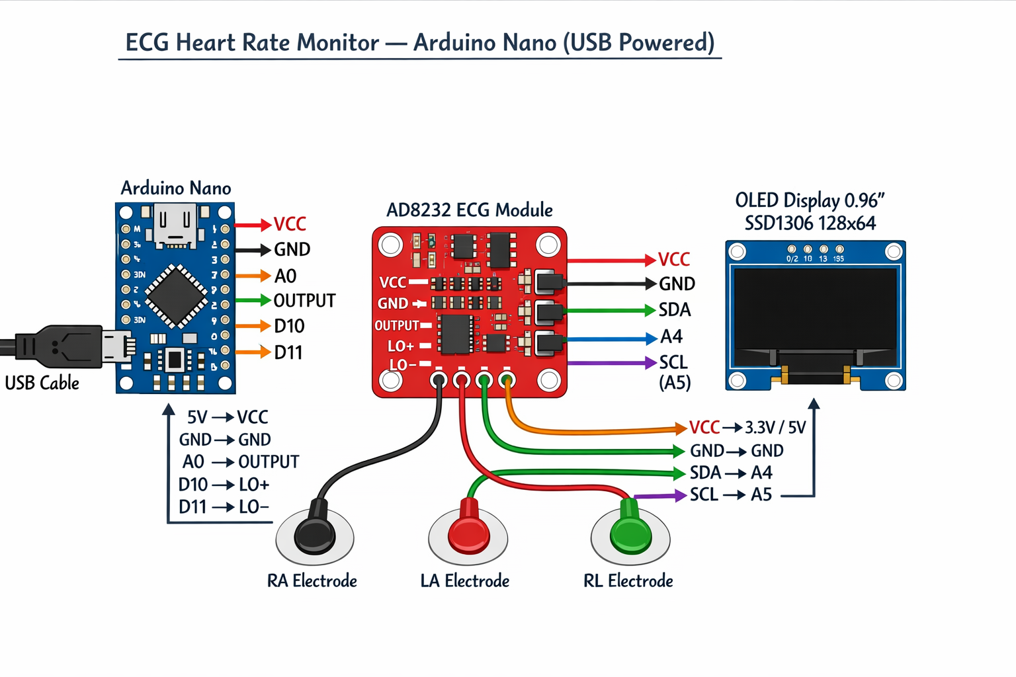
Methodology and Modeling
Experimental Setup
The Arduino is connected to the AD8232 ECG sensor and OLED display on a breadboard
ECG electrodes are attached to standard limb positions for signal acquisition
Serial Monitor / Plotter is used to verify ECG waveform and BPM detection
The OLED displays both the ECG waveform and BPM value in real time
Figure 1: Block diagram of the system

Slide 12
Methodology and Modeling
The ECG waveform on the OLED appears as a scrolling signal
BPM updates continuously with every detected heartbeat
Adjustable threshold values help ensure accurate beat detection for different users
The setup is low‑cost, compact, and portable
Suitable for educational, experimental, and basic heart‑monitoring purposes
Figure 1: Block diagram of the system

Slide 13
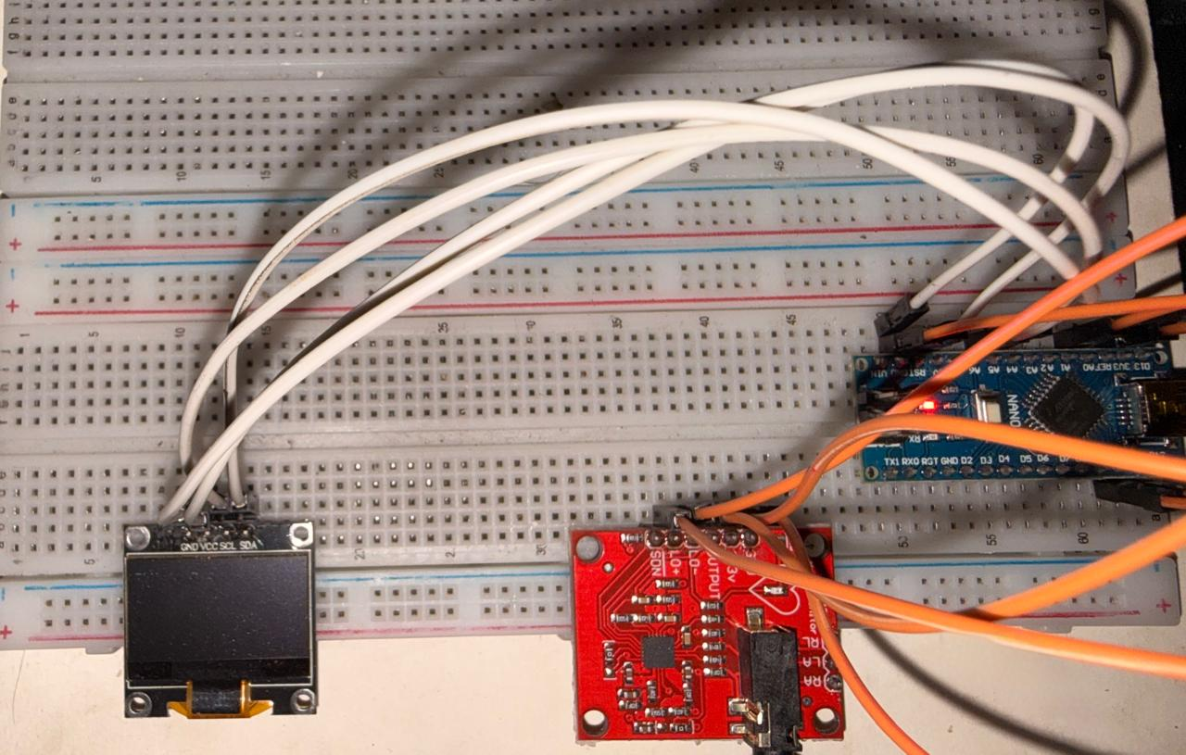
Methodology and Modeling
The AD8232 ECG sensor, Arduino Nano, and OLED display were connected on a breadboard according to the circuit diagram
Electrodes were attached to the body to collect ECG signals
Arduino IDE was used to program the microcontroller
The program reads the ECG signal, detects R‑peaks, and calculates BPM
Figure 2- Heart Rate Monitoring System

Slide 14
Methodology and Modeling
The BPM value is displayed on the OLED screen in real‑time
The ECG waveform is also shown live on the Serial Plotter
Threshold and timing values were adjusted to improve accuracy
The system was tested repeatedly to ensure stable operation
Figure 2- Heart Rate Monitoring System

Slide 15
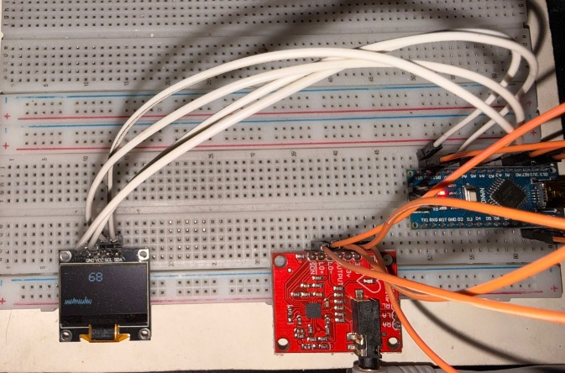
Results and Discussions
The system successfully measured real‑time ECG signals and heart rate (BPM) for different subjects
The OLED display showed numerical BPM values, updated every second
A dynamic ECG waveform was displayed, clearly showing the PQRST pattern with visible heartbeat peaks
BPM values ranged from 55 to 160 BPM, depending on the subject’s activity level and heart‑rate variation
Figure 3- Heart Rate Monitoring System

Slide 16
Results and Discussions
The ECG waveform closely matched the analog ECG signal, showing good responsiveness and reliability
Serial Monitor/Plotter was used to validate BPM calculations using the measured RR‑intervals
Figure 3- Heart Rate Monitoring System

Slide 17
Results and Discussions
Cost Analysis
Component | Approximate Cost (BDT)
Arduino Nano | 420
AD8232 ECG Sensor | 750
OLED Display (128×64) | 300
Wires | 20
Power Supply (Laptop USB) | 0
Total Estimated Cost: 1490 BDT

Slide 18
Results and Discussions
Limitations in the Project
The system is not suitable for clinical diagnosis; it is intended for experimental and educational purposes only.
ECG signal quality can be affected by electromagnetic interference, electrode placement, and movement artifacts.
The BPM detection algorithm may miss irregular or very rapid heartbeats due to the threshold-based method.
The OLED display size limits the waveform resolution and the number of data points visible at a time.
No wireless or remote monitoring capability is included in this version.

Slide 19
Conclusions and Future Endeavor
Conclusion
The project successfully developed a real‑time ECG‑based heart‑rate monitoring system using the AD8232 sensor and Arduino Nano
The system was able to measure ECG signals and calculate BPM accurately under normal conditions
BPM was displayed on the OLED screen, and the ECG waveform was visualized in real time
The device is low‑cost, compact, and suitable for educational and experimental use
Testing showed that the system works best when the subject is relaxed and electrodes are properly attached
Future Endeavors
Improve signal filtering to reduce motion noise and interference
Develop a wearable version for more comfortable long‑term monitoring
Add Bluetooth / Wi‑Fi connectivity for mobile or cloud monitoring
Include data logging for storing ECG and BPM history
Design a protective enclosure for better portability and safety

Slide 20
Raferences
[1] Analog Devices, Inc., “AD8232: Heart Rate Monitor Front End — Datasheet,” 2023.
[2] G. Rajender, S. Mubeen, and E. Parvathi, “Development of an Arduino‑based ECG monitoring system using the AD8232 sensor,” International Journal of Biomedical Engineering and Technology, vol. 35, no. 2, pp. 145–154, 2021.
[3] K. Mounika, R. Reddy, and P. Kumar, “IoT‑based real‑time ECG monitoring system using AD8232 and ESP32,” International Journal of Electronics and Communication Engineering, vol. 14, no. 3, pp. 55–62, 2022.
[4] L. Chen and Y. Zhang, “Wearable ECG monitoring systems for continuous health tracking,” Biomedical Signal Processing and Control, vol. 76, pp. 1–10, 2022.
[5] M. Ehnesh, A. Darvishi, and H. Jafari, “Design and implementation of a portable ECG monitoring device,” SN Applied Sciences, vol. 2, no. 9, pp. 1–8, 2020.
[6] Arduino, “Arduino Nano Technical Specifications,” available online: https://www.arduino.cc/ (Accessed: Jan. 4, 2026).
[7] Adafruit Industries, “SSD1306 OLED Display Datasheet and Guide,” available online: https://learn.adafruit.com/ (Accessed: Jan. 4, 2026).

Slide 21
Thanks for listening our presentation….
?

